Slide 1
Lecture 23: Intermolecular forces
California State University, Fullerton
2023 Fall Semester – Chem 123

Slide 2

QUESTIONS, COMMENTS, AND CONCERNS?

Slide 3
Outline
Announcements
Highlights prior lecture:
Valence Bond Theory – Hybrid Orbitals
Molecular Orbital Theory – Molecular Orbitals
Reading a Research Article
Ch. 12: Liquids and Solids
Intermolecular Forces – Connection to Real World
Phase Changes and Heating Curves
Vapor Pressure, Viscosity, Freezing/Boiling Point, and Surface Tension
Phase Diagrams
Types of Solids

Slide 4
announcements
Final Exam on Dec 11th at 5:00pm – 6:50pm in MH 121
Cumulative – 50% covering new materials and 50% covering old materials
6 – 8 questions
Finished exam grades
EC opportunity up to 10 pts towards homework assignment grade
Online Homework Ch 11 due Tues, Nov 28th and Ch 12 due Tues, Dec 5th at 11:59pm
For final exam, opportunity to replace exam 2 or exam 3 score

Slide 5
Outline
Announcements
Highlights prior lecture:
Valence Bond Theory – Hybrid Orbitals
Molecular Orbital Theory – Molecular Orbitals
Reading a Research Article
Ch. 12: Liquids and Solids
Intermolecular Forces – Connection to Real World
Phase Changes and Heating Curves
Vapor Pressure, Viscosity, Freezing/Boiling Point, and Surface Tension
Phase Diagrams
Types of Solids

Slide 6
Outline
Announcements
Highlights prior lecture:
Valence Bond Theory – Hybrid Orbitals
Molecular Orbital Theory – Molecular Orbitals
Reading a Research Article
Ch. 12: Liquids and Solids
Intermolecular Forces – Connection to Real World
Phase Changes and Heating Curves
Vapor Pressure, Viscosity, Freezing/Boiling Point, and Surface Tension
Phase Diagrams
Types of Solids

Slide 7
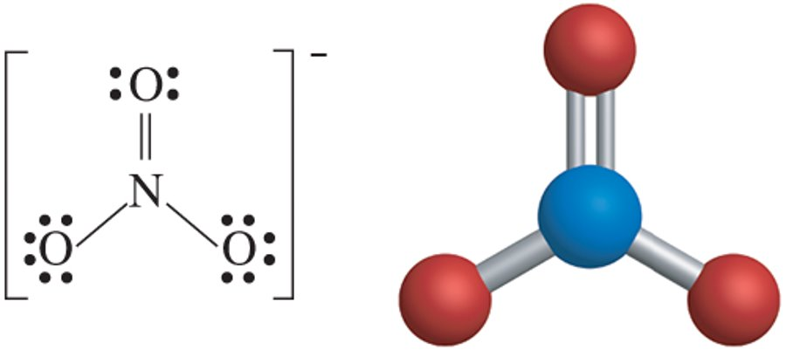
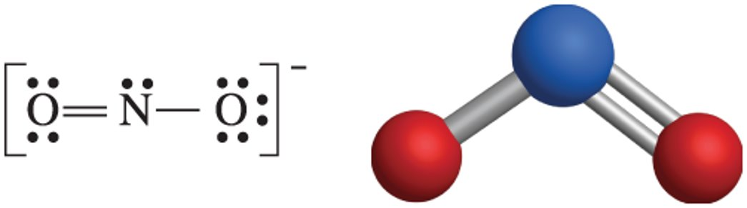
Atoms and molecules
Q: What are molecules made of?
Q: What are atoms made of?
Q: What determines the chemical properties of materials?

Slide 8
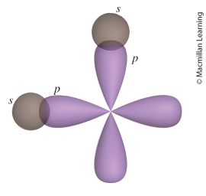
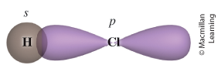
Valence bond (VB) theory
Recall Lewis Structure and VSEPR Model. What are their purposes?
VB Theory Assumptions:
Electrons occupy atomic orbitals of individual atoms within a molecule
Electrons of one atom are attracted to the nucleus of another atom
Concept of Bond – overlap of atomic orbitals

Slide 9
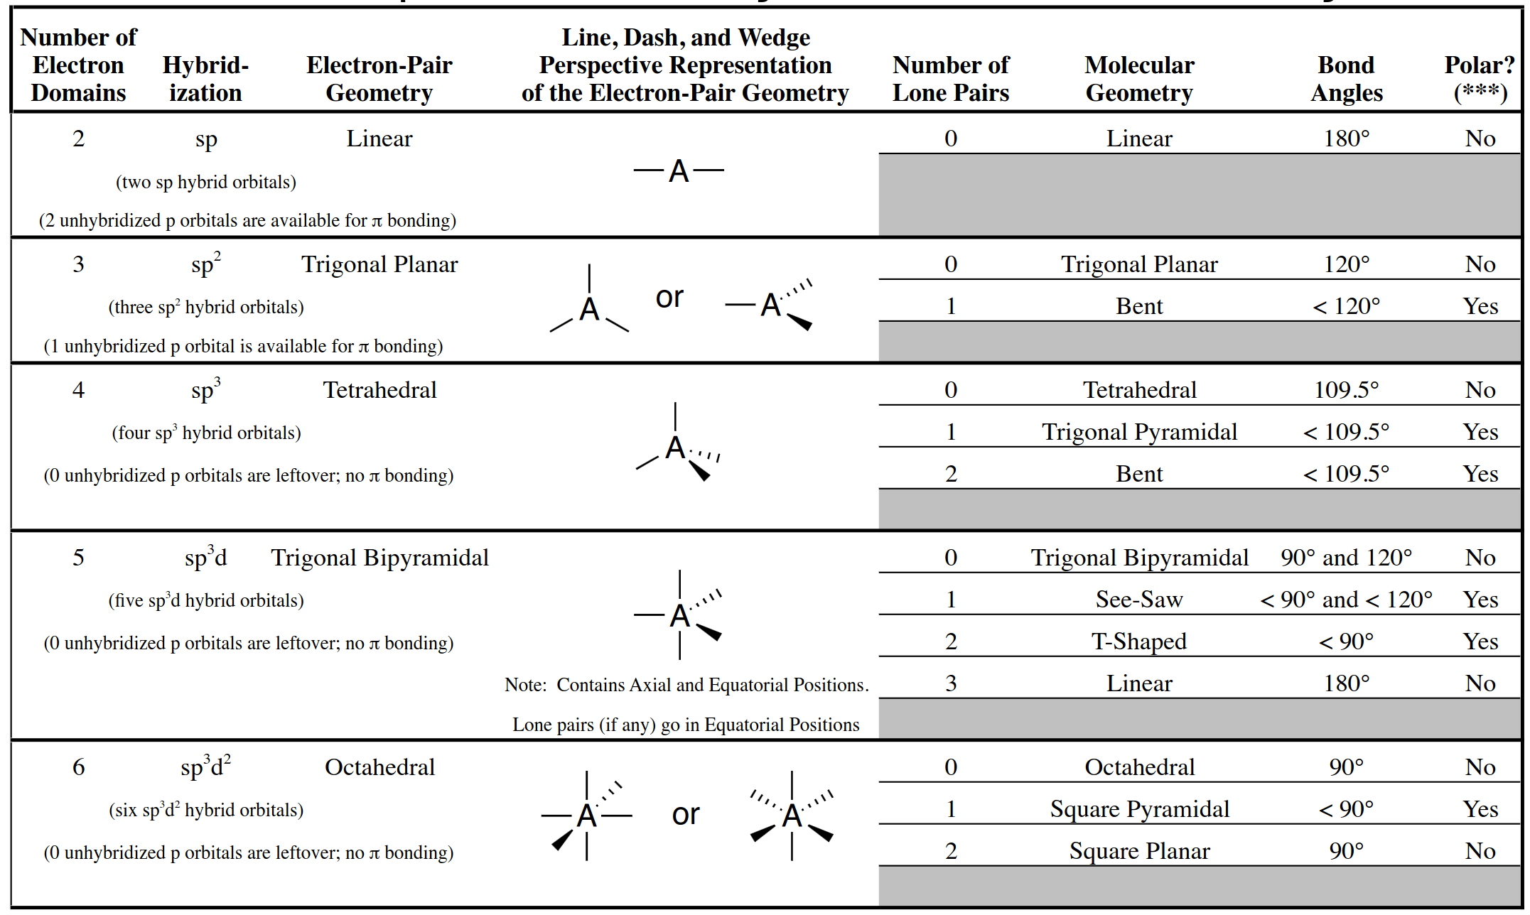
Table of hybridized orbitals and molecular geometries

Slide 10
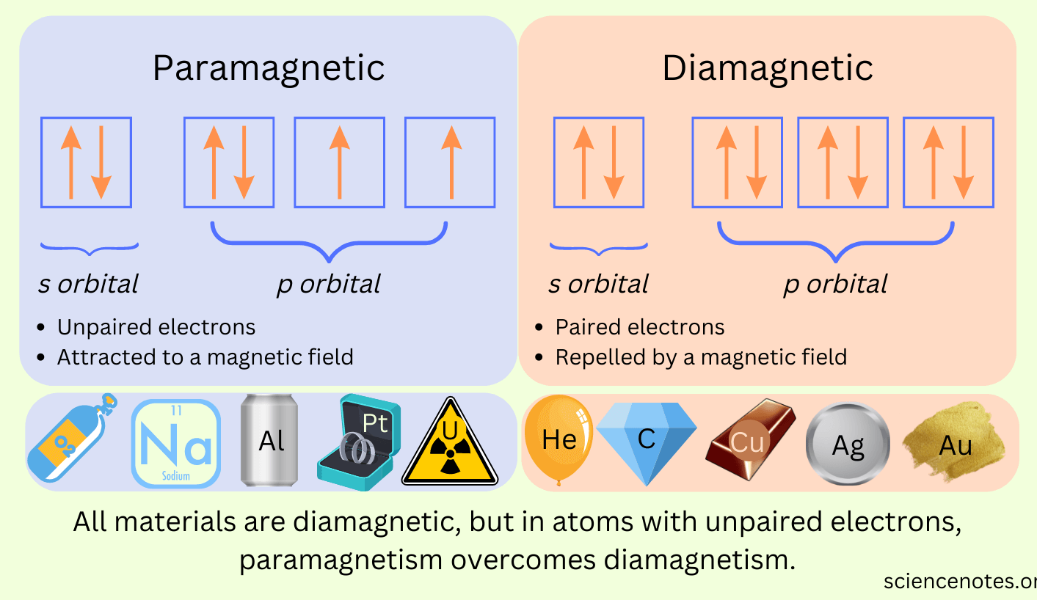
Molecular orbital theory
Limitation of Valence Band Theory – unable to explain electronic energy within the molecule and magnetic properties such as paramagnetism (unpaired electrons) and diamagnetism (paired electrons)

Slide 11
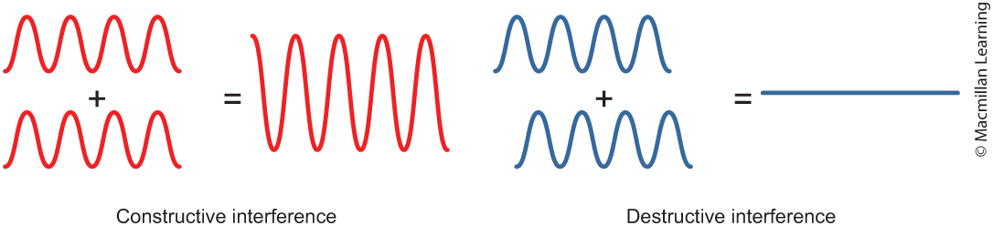
Molecular orbital theory
Atomic orbitals of different atoms combine to form molecular orbitals that delocalized over the resulting molecule
Atomic orbitals can combine constructively or destructively
Q: How is this different from the Valence Bond Theory?

Slide 12
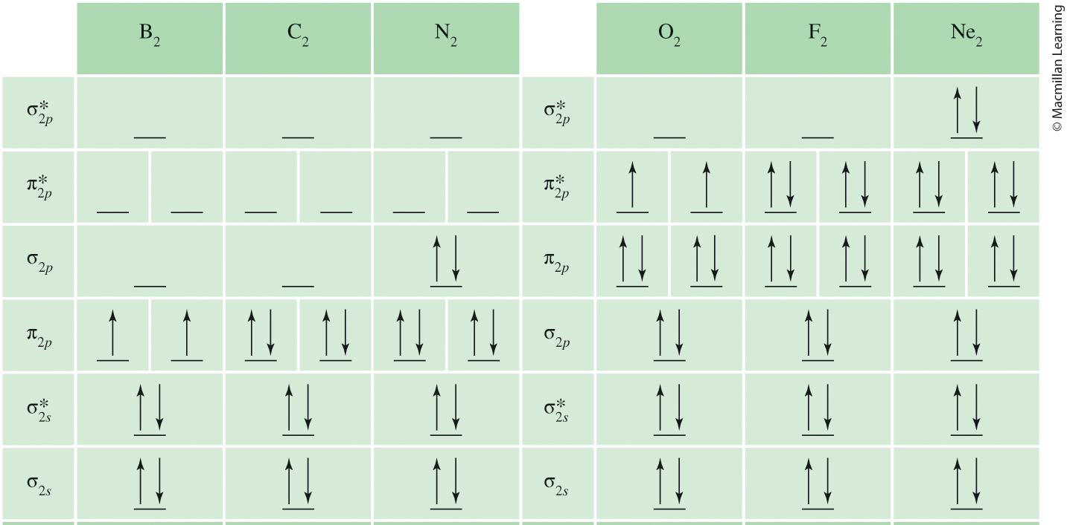
Molecular orbital theory
Filling molecular orbitals follow Hund's Rule

Slide 13
Outline
Announcements
Highlights prior lecture:
Valence Bond Theory – Hybrid Orbitals
Molecular Orbital Theory – Molecular Orbitals
Reading a Research Article
Ch. 12: Liquids and Solids
Intermolecular Forces – Connection to Real World
Phase Changes and Heating Curves
Vapor Pressure, Viscosity, Freezing/Boiling Point, and Surface Tension
Phase Diagrams
Types of Solids

Slide 14
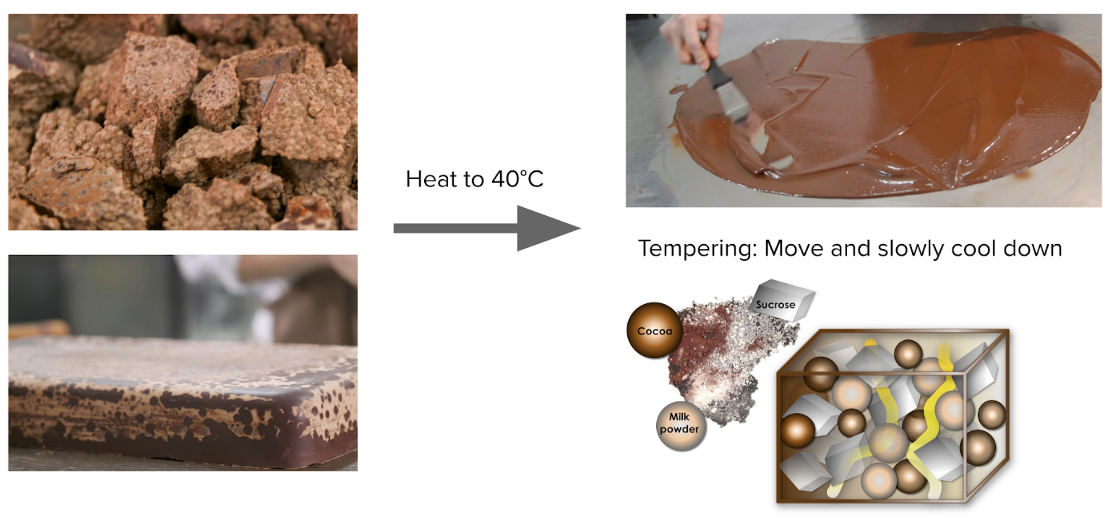
Real world connection: intermolecular forces
Chocolate Making Process

Slide 15
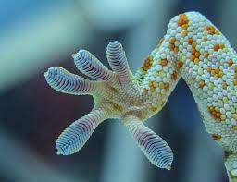
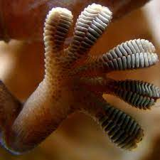
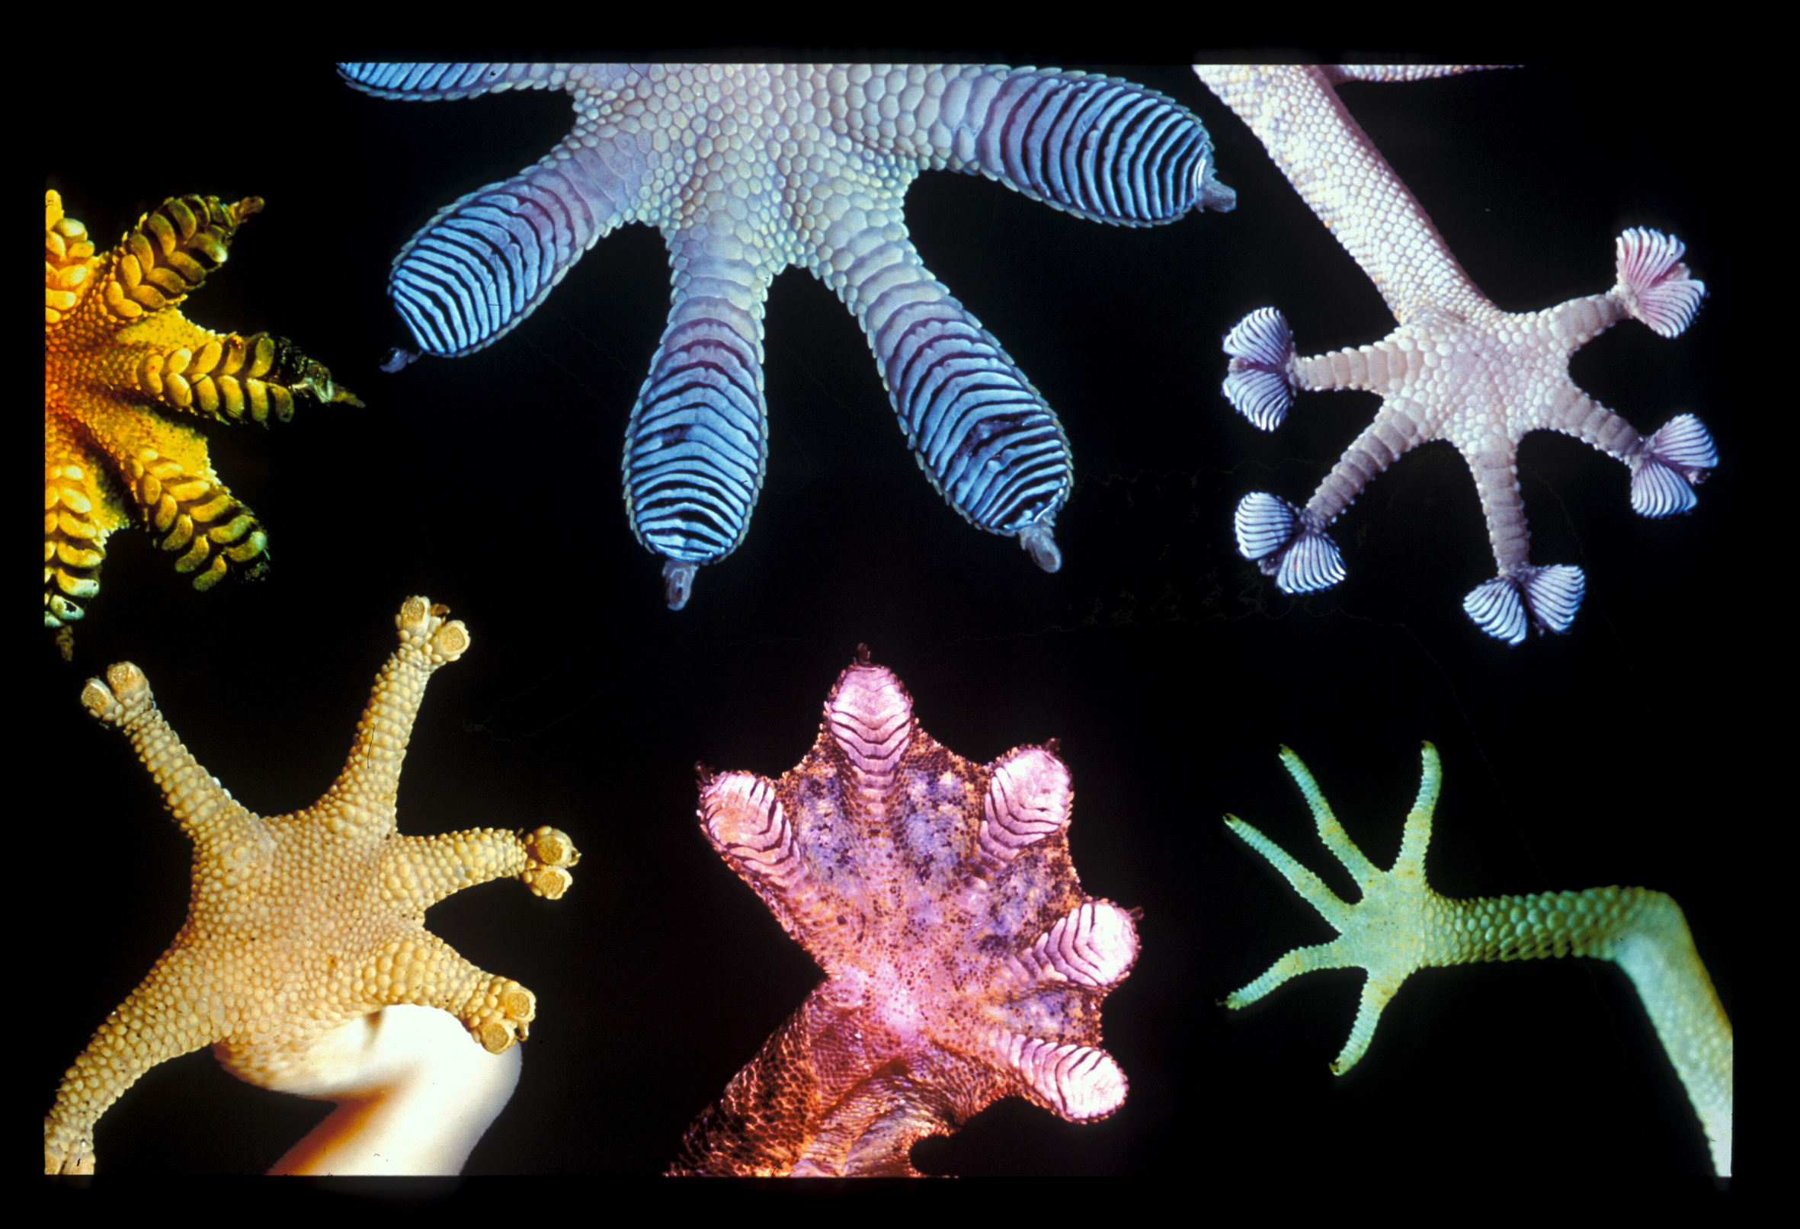
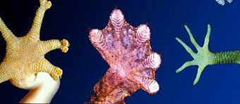
Real world connection: intermolecular forces
Gecko's Feet

Slide 16
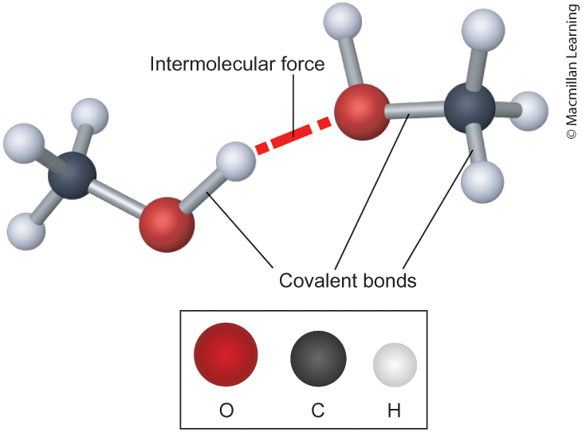
Intermolecular forces
Intramolecular interactions – interactions within the molecule
Intermolecular interactions – Interactions between molecules
Play an important role determine relative freezing/boiling points, viscosity, vapor pressure, and surface tension

Slide 17
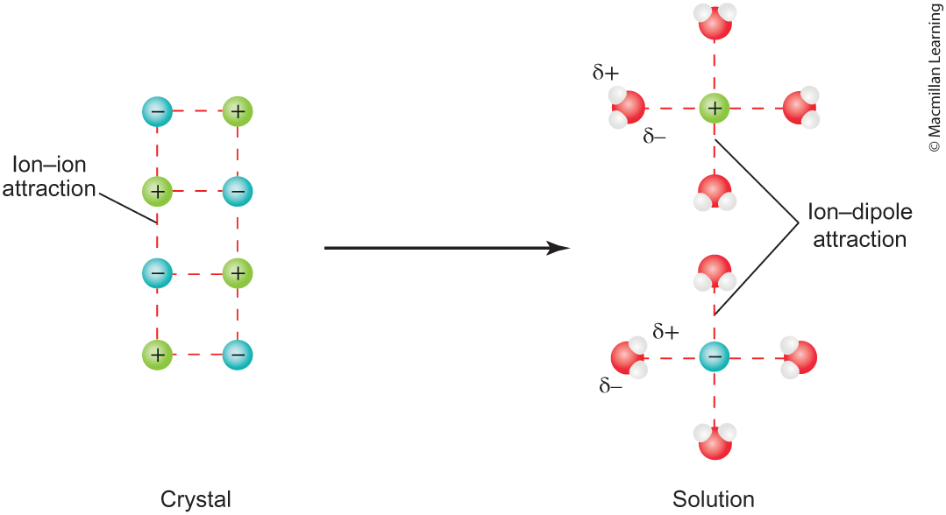
Types of Intermolecular forces: Ion-Dipole (strongest)

Slide 18
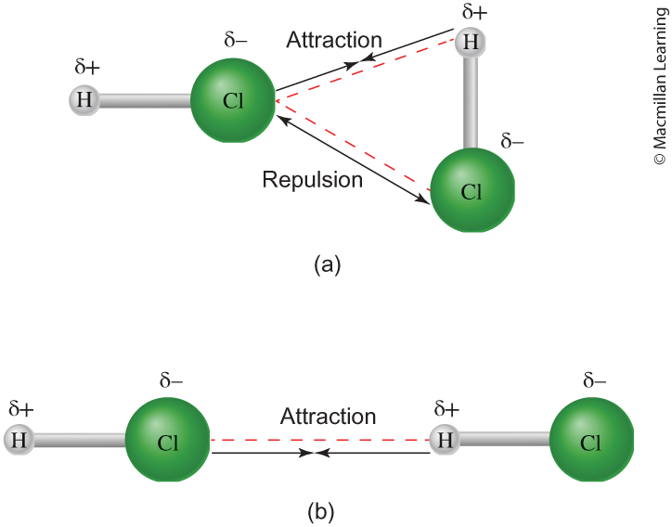
Types of Intermolecular forces: Dipole-Dipole

Slide 19
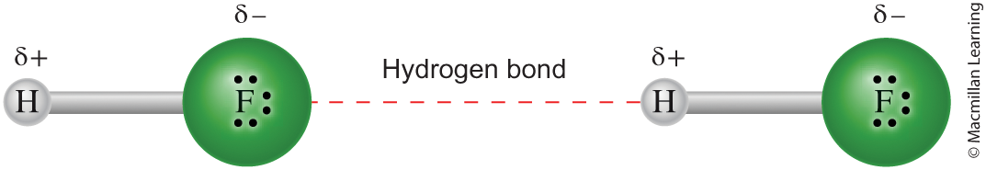
Type of intermolecular forces: Hydrogen bonding
A stronger type of dipole-dipole interaction, only applicable when H atom is attached to N, O, and F (due to high electronegativity)
Hydrofluoric acid (HF) has one hydrogen donor and 3 lone pairs to accept the hydrogen

Slide 20
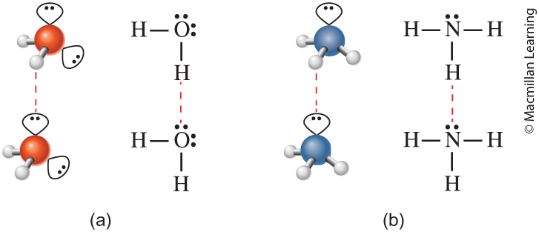
Type of intermolecular forces: Hydrogen bonding
A stronger type of dipole-dipole interaction, only applicable when H atom is attached to N, O, and F (due to high electronegativity)
Water (H₂O) has 2hydrogen donors and 2 lone pairs
Ammonia (NH₃) has 3 hydrogen donors but only 1 lone pairs

Slide 21

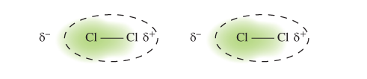
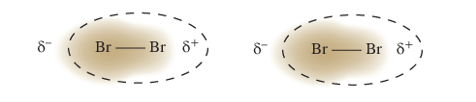
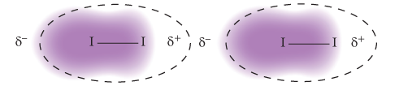
Type of intermolecular forces: Dispersion (weakest)
Universal and present in all molecules
Textbook definition – instantaneous dipole moments
Strength of dispersion grows with the size of the molecule

Slide 22
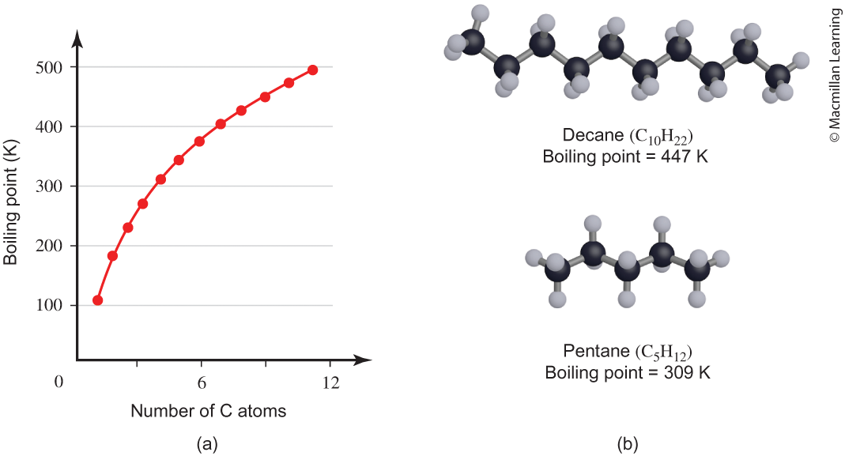
Intermolecular forces and boiling point
Stronger intermolecular forces lead to higher boiling point
Q: Identify the intermolecular forces for decane and pentane.

Slide 23
Gecko's feet – purely dispersion interactions
Q: What gives? Isn't dispersion interactions the weakest?

Slide 24
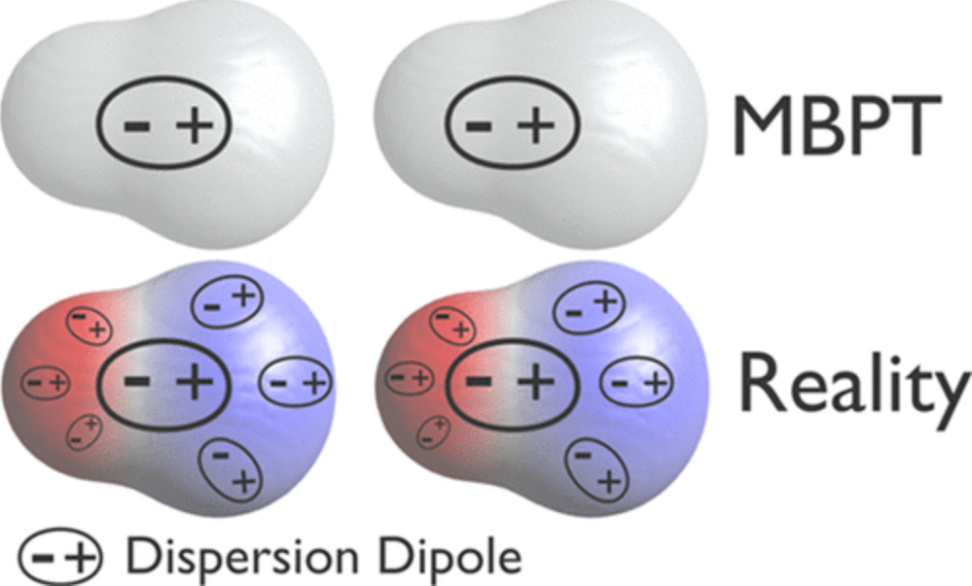
Divergence of Many body perturbation theory
Textbook definition – instantaneous dipole moments
Research perspective – dispersion dipoles and electronic screening (intra- and interscreening)

Slide 25
Example: water and ammonia intermolecular forces
Which one has the stronger intermolecular forces? Hint: Identify all intermolecular forces.

Slide 26
Outline
Announcements
Highlights prior lecture:
Valence Bond Theory – Hybrid Orbitals
Molecular Orbital Theory – Molecular Orbitals
Reading a Research Article
Ch. 12: Liquids and Solids
Intermolecular Forces – Connection to Real World
Phase Changes and Heating Curves
Vapor Pressure, Viscosity, Freezing/Boiling Point, and Surface Tension
Phase Diagrams
Types of Solids

Slide 27
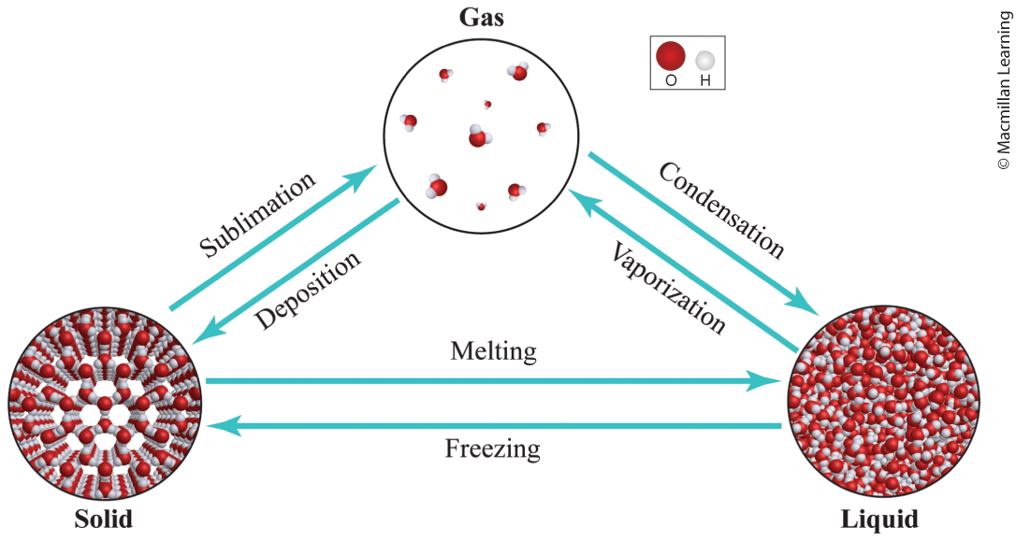
Phase changes
ΔHfus - enthalpy of fusion is energy refer to changes between solid and liquid (kJ/mol)
ΔHvap - enthalpy of vaporization is energy refer to changes between liquid and gas (kJ/mol)
ΔHsub - enthalpy of sublimation is energy refer to changes between solid and gas (kJ/mol)

Slide 28
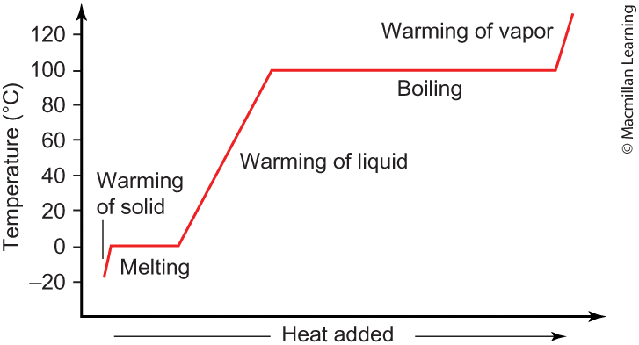
Calculation amount of heat for phase changes
Heating up materials (solid, liquid, and vapor) use q = mCΔT
Enthalpy of fusion, vaporization, and sublimation (pay attention to kJ/mol or kJ/g)

Slide 29
Outline
Announcements
Highlights prior lecture:
Valence Bond Theory – Hybrid Orbitals
Molecular Orbital Theory – Molecular Orbitals
Reading a Research Article
Ch. 12: Liquids and Solids
Intermolecular Forces – Connection to Real World
Phase Changes and Heating Curves
Vapor Pressure, Viscosity, Freezing/Boiling Point, and Surface Tension
Phase Diagrams
Types of Solids

Slide 30
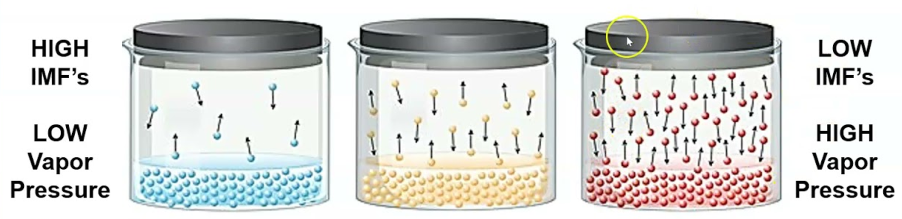
Vapor pressure and intermolecular forces
Stronger intermolecular forces lead to lower vapor pressure
Vapor pressure – vapor present above the liquid surface (exists an equilibrium between the liquid and gas phase of the compound

Slide 31
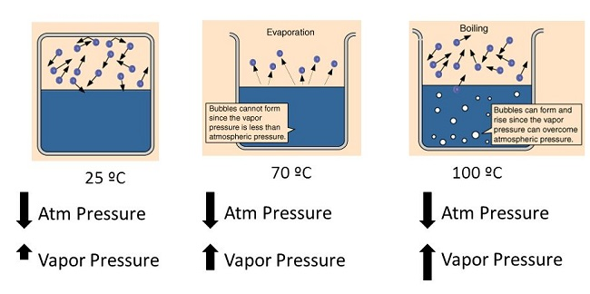
Vapor pressure and boiling point
Liquids boil when the vapor pressure is equal to the atmospheric pressure (1 atm or 760 mm Hg)
Liquid has a high vapor pressure at room temperature – lower boiling point

Slide 32
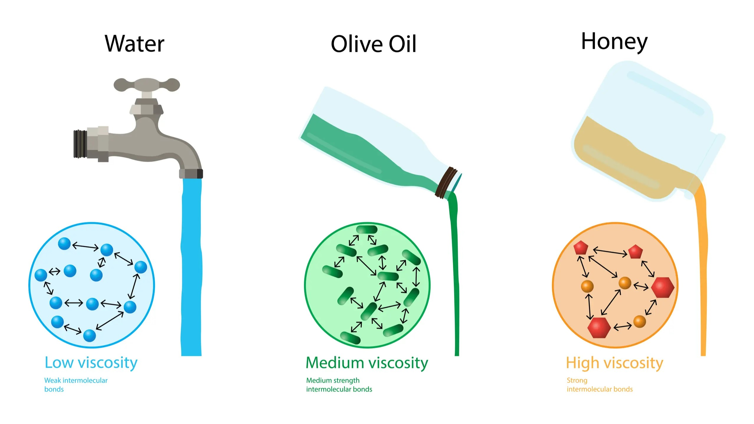
Viscosity and intermolecular forces

Slide 33
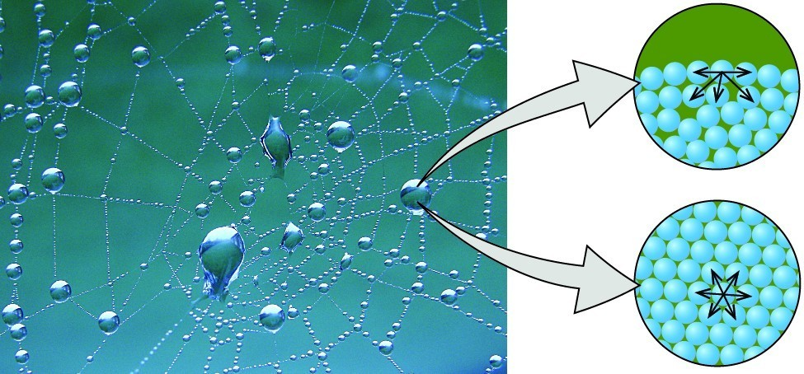
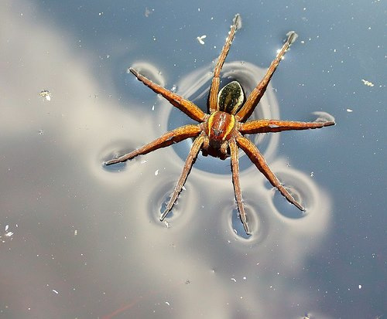
Surface tension and intermolecular forces

